Slide 1
Operational Amplifier
Originally, op-amps were so named because they were used to model the basic mathematical operations of addition, subtraction, integration, differentiation, etc. in electronic analog computers. In this sense a true operational amplifier is an ideal circuit element
Chapter No 2

Slide 2
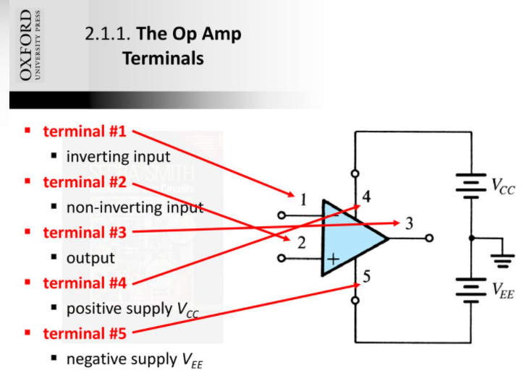
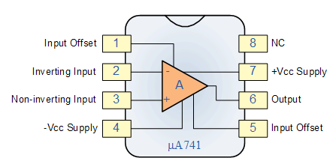

Slide 3
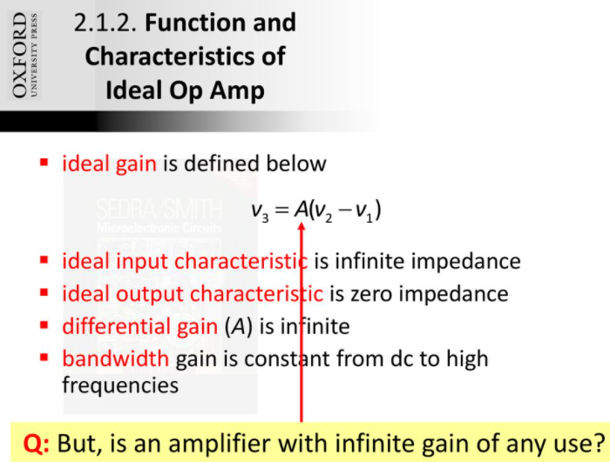
A

Slide 4
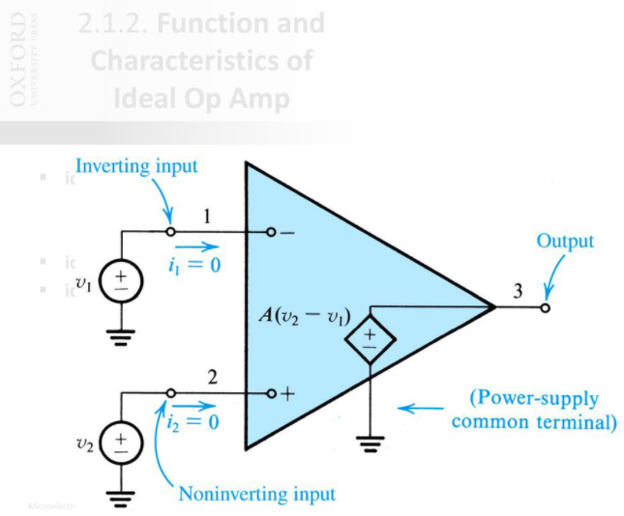
Represents a dependent voltage source
For Ideal Op-Amp input current is zero , because of infinite input impedance

Slide 5
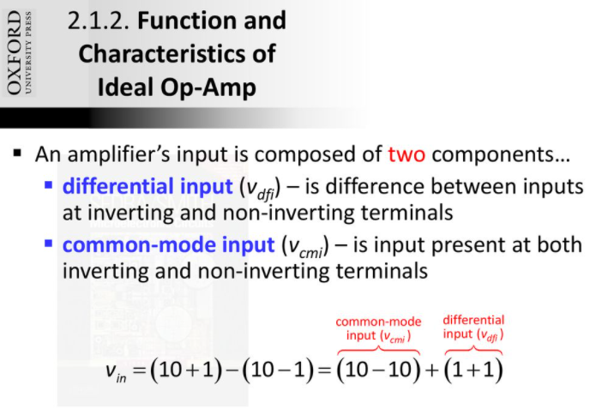
Differential input are complementary

Slide 6
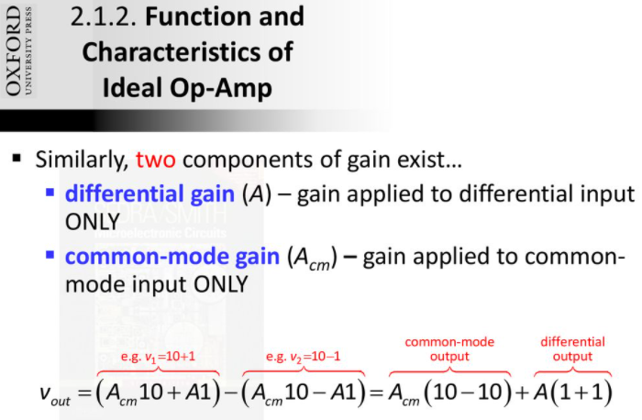

Slide 7
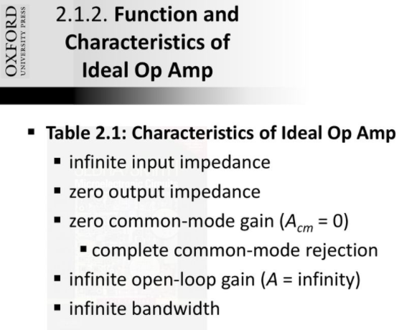

Slide 8
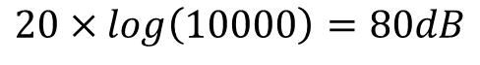
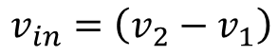
$$v_{3 }=μ×v_{d}= μ×G_{m}×\left(v_{2}−v_{1}\right)×R$$
$$v_{in}=\left(v_{2}−v_{1}\right)$$
$$A=\frac{v_{3}}{v_{in}}=μ×G_{m}×R=100×0.01×10000=10000$$
$$20×log\left(10000\right)=80dB$$

Slide 9
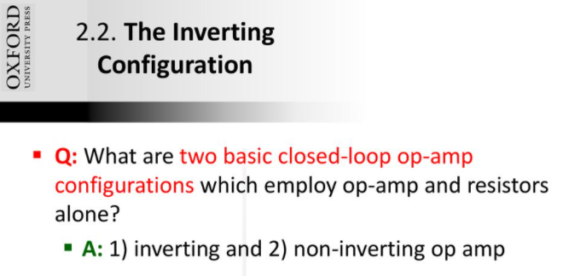

Slide 10
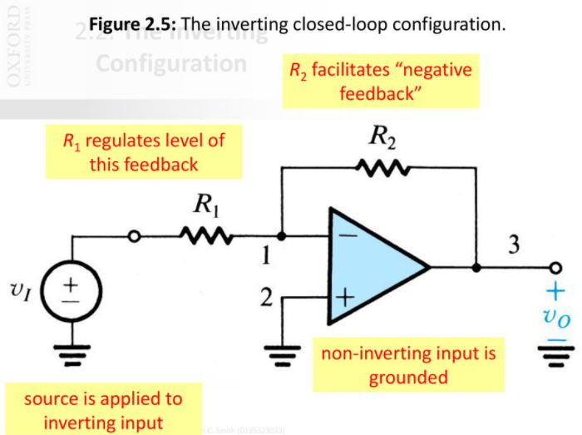
Feedback in general can be positive or negative
For most applications we apply negative feedback

Slide 11
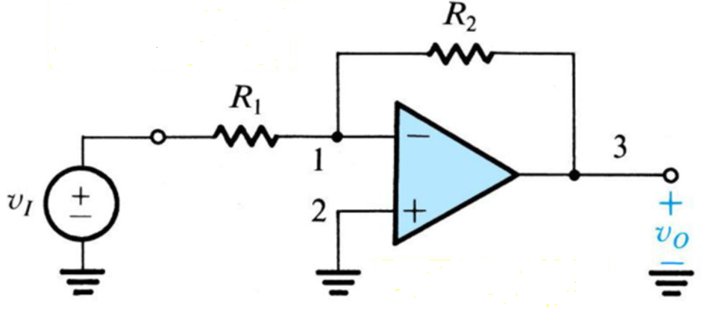
Figure shows the inverting configuration.
We speak of R2 as applying negative feedback;
If R2 were connected between terminals 3 and 2 we would have called this positive feedback.
Note that R2 closes the loop around the op amp. In addition to adding R2, we have grounded terminal 2 and connected a resistor R1 between terminal 1 and an input signal source with a voltage vI.
The output of the overall circuit is taken at terminal 3 (i.e., between terminal 3 and ground). Terminal 3

Slide 13
This also implies that if the output is small voltage say 5 volt P-P, and the gain is significantly high , then there must be negligible difference between the two inputs

Slide 15
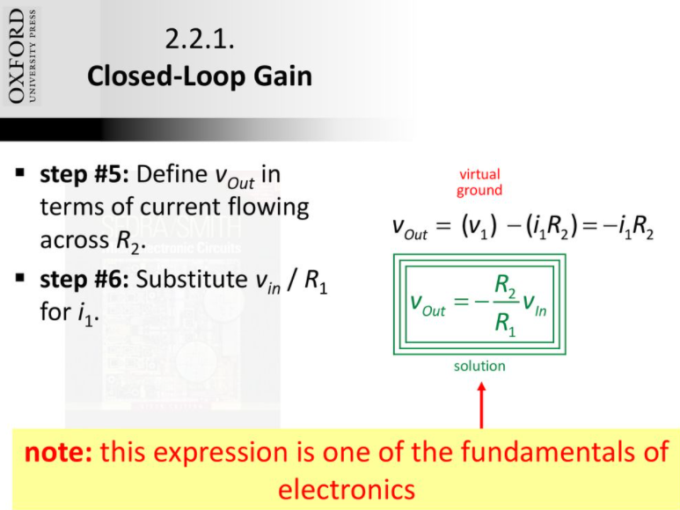
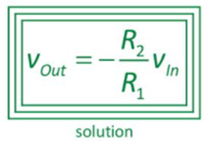

Slide 17
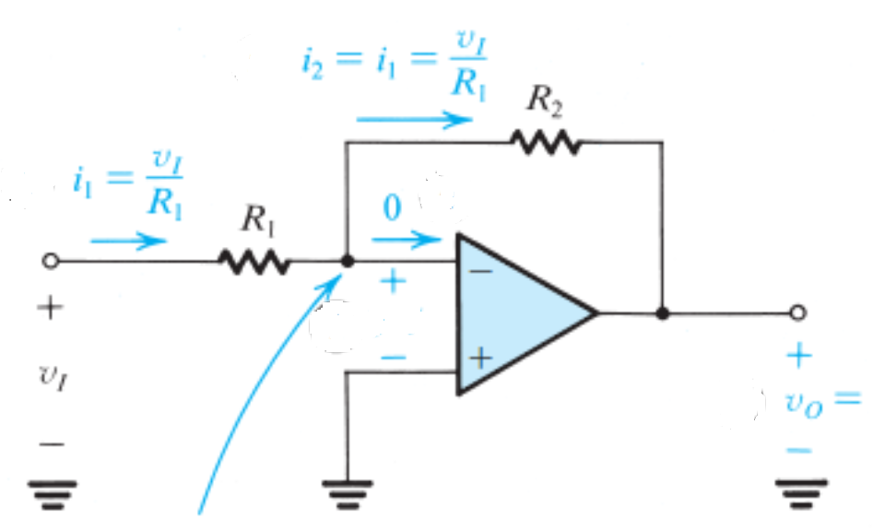

Slide 18
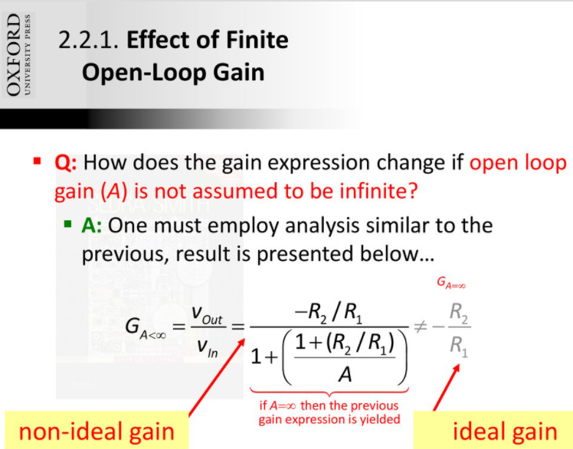

Slide 19
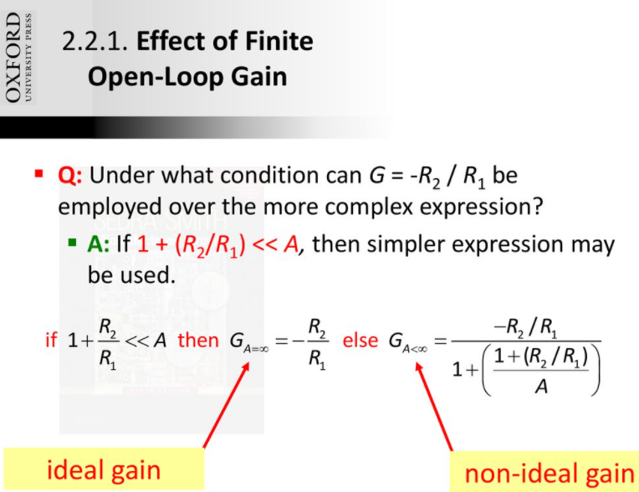

Slide 20
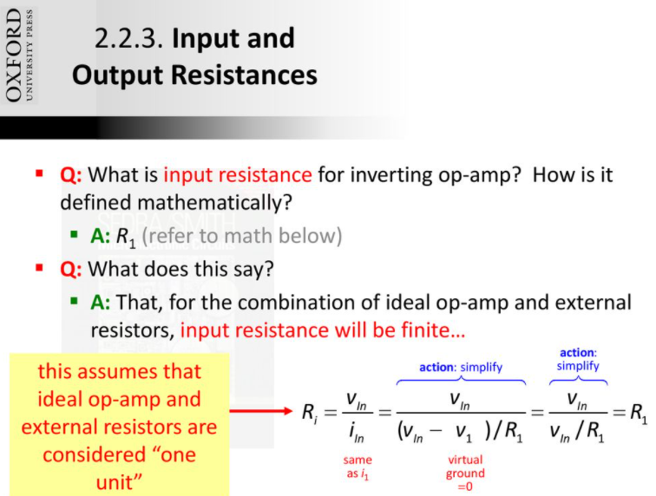
Virtual ground

Slide 21
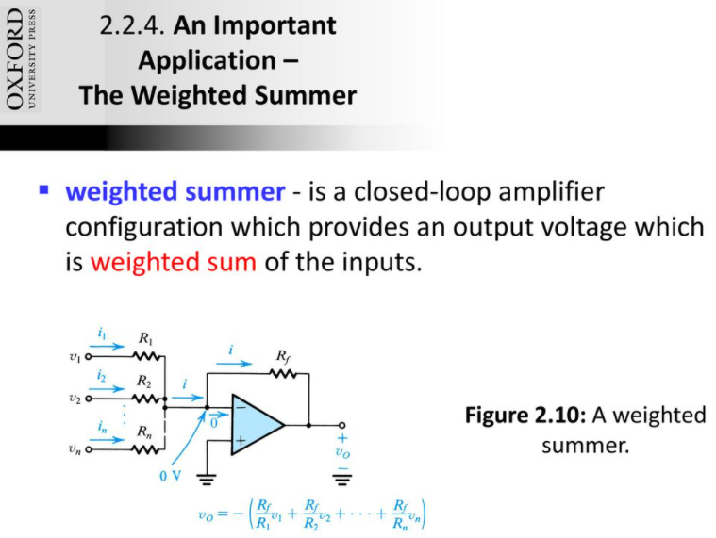

Slide 22
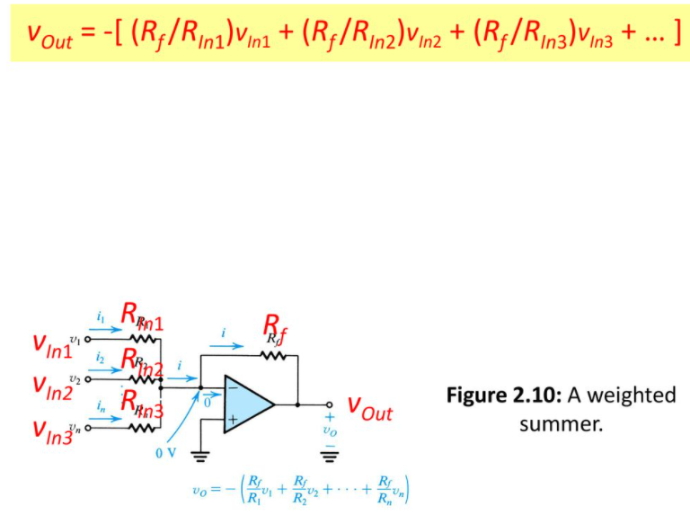

Slide 23
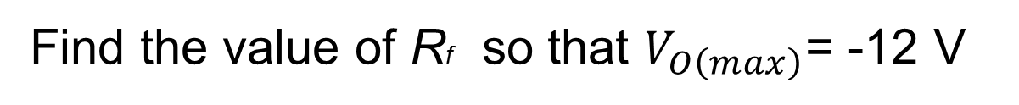
Figure shows a circuit for a digital-to-analog converter (DAC). The circuit accepts a 4-bit input binary word a3a2a1a0, where a0, a1, a2, and a3 take the values of 0 or 1, and it provides an analog output voltage vO proportional to the value of the digital input. Each of the bits of
the input word controls the correspondingly numbered switch. For instance, if a2 is 0 then switch S2 connects the 20-kὨ resistor to ground, while if a2 is 1 then S2 connects the 20-kὨ resistor to the +5-V power supply.
Find the value of Rf so that $V_{O\left(max\right)}$= -12 V

Slide 24
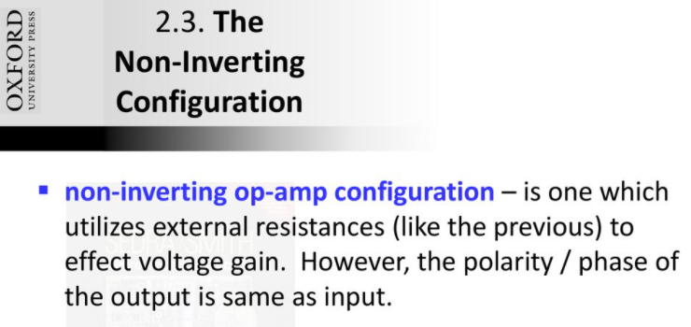

Slide 25
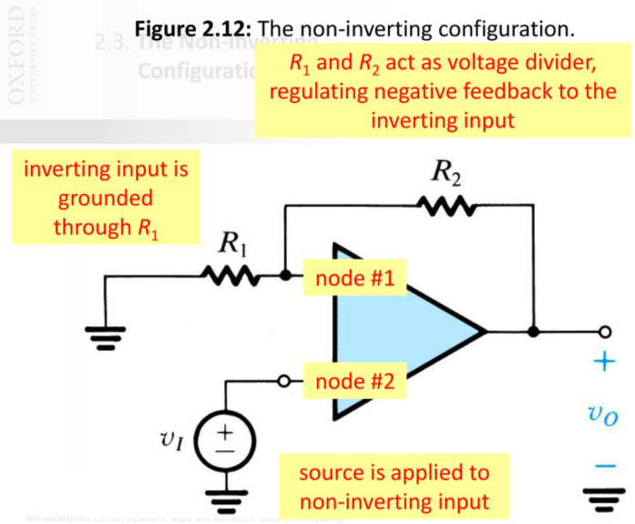

Slide 26
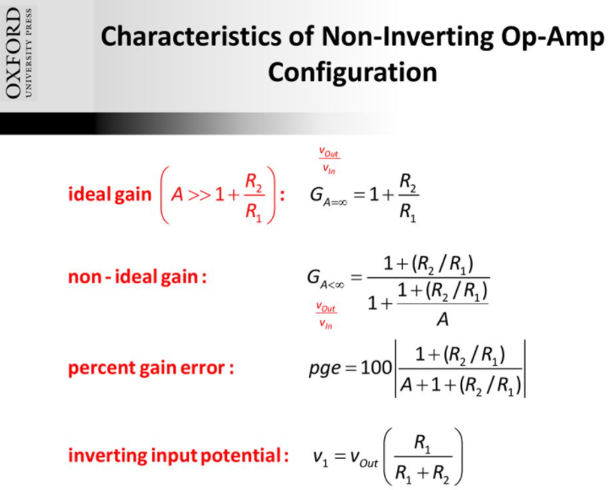

Slide 27
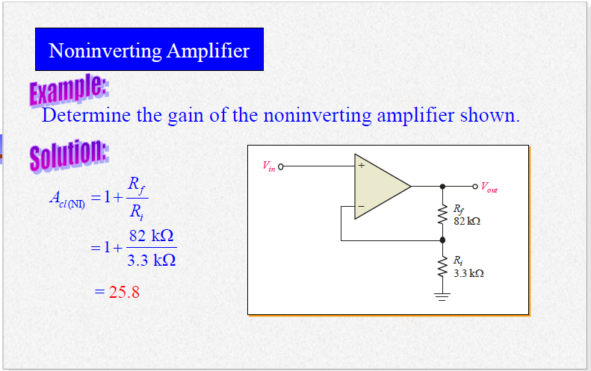

Slide 28
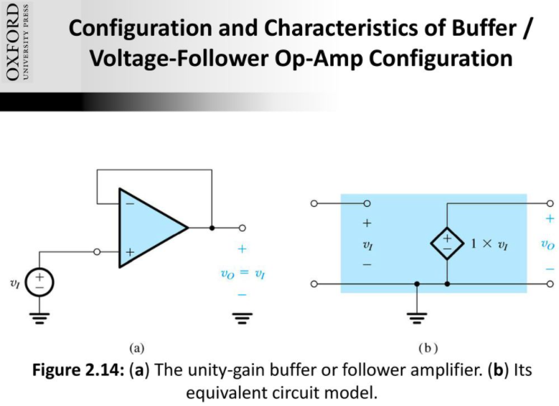
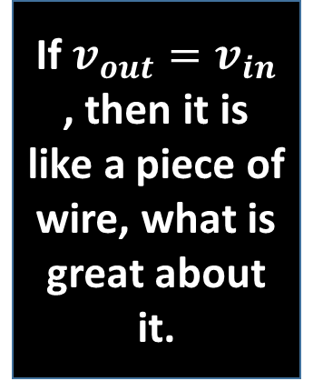
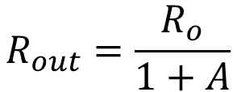
If $v_{out}=v_{in}$ , then it is like a piece of wire, what is great about it.
Extremely low output impedance; so can easily drive the load
$$R_{out}=\frac{R_{o}}{1+A}$$
The input impedance is infinity , so does not load the source

Slide 29
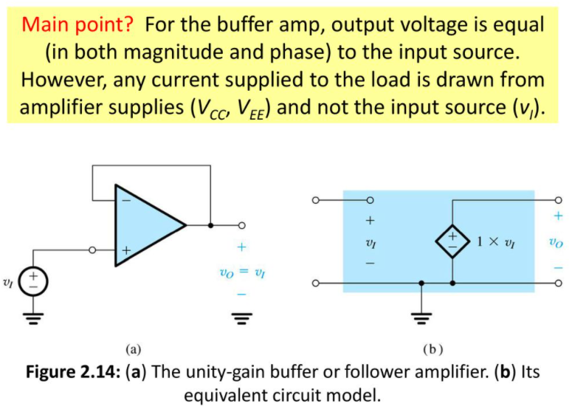

Slide 30
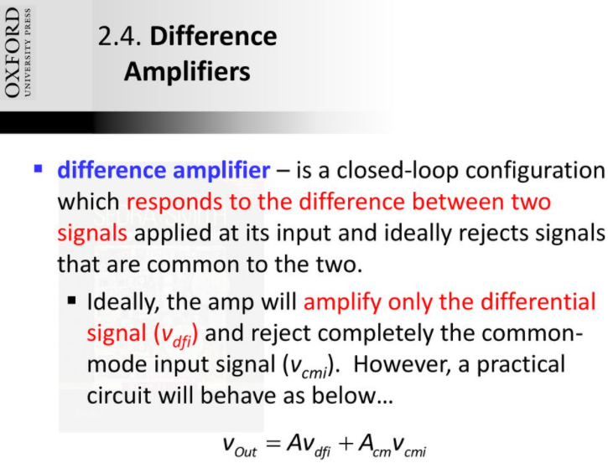

Slide 31
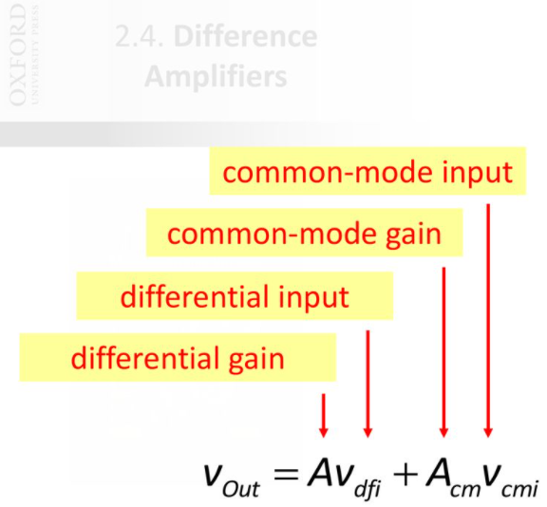

Slide 32
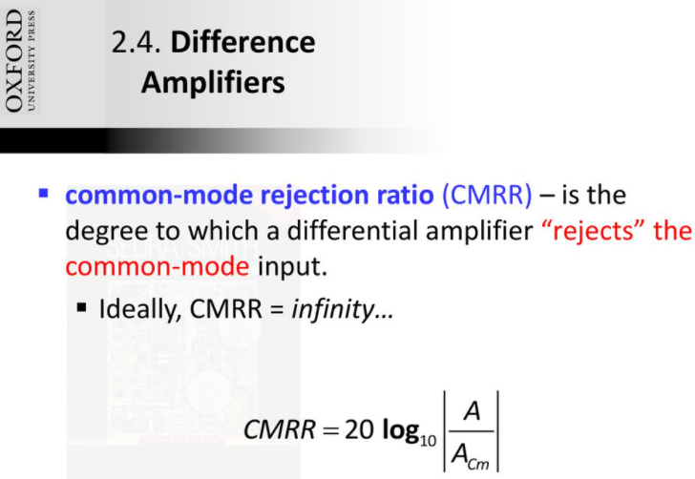

Slide 33
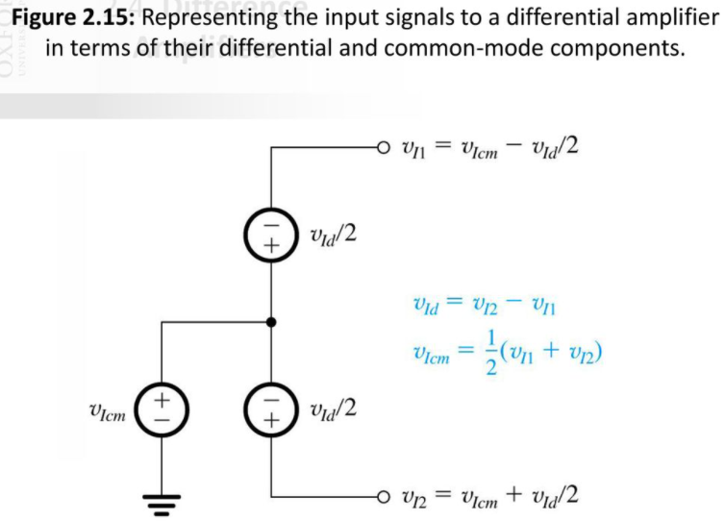

Slide 34
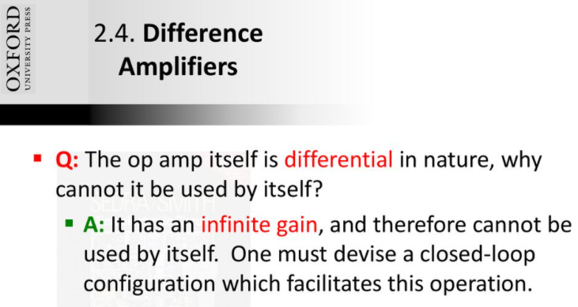

Slide 35
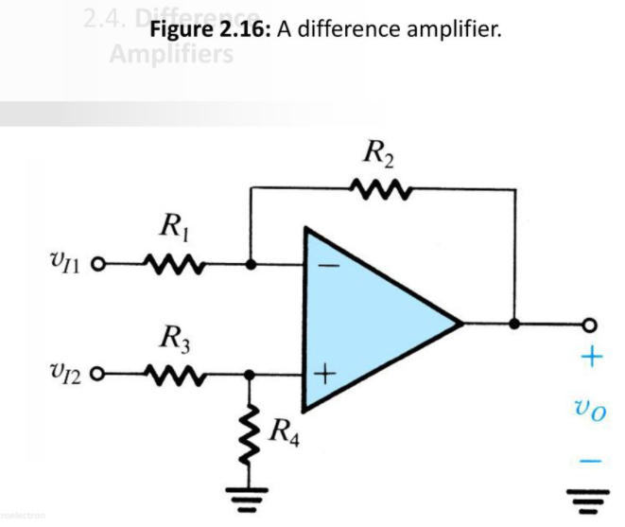

Slide 36
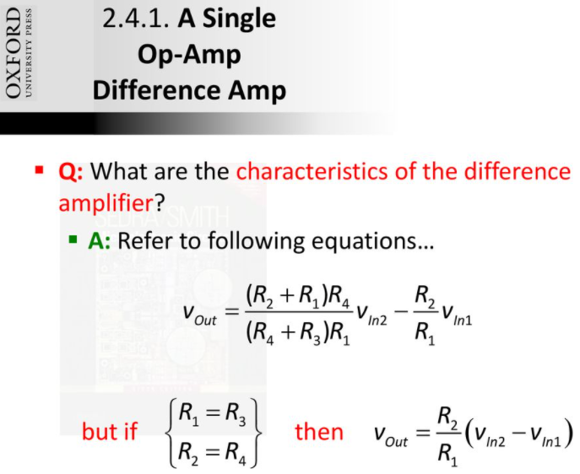

Slide 37
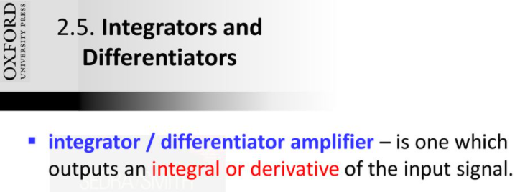

Slide 38
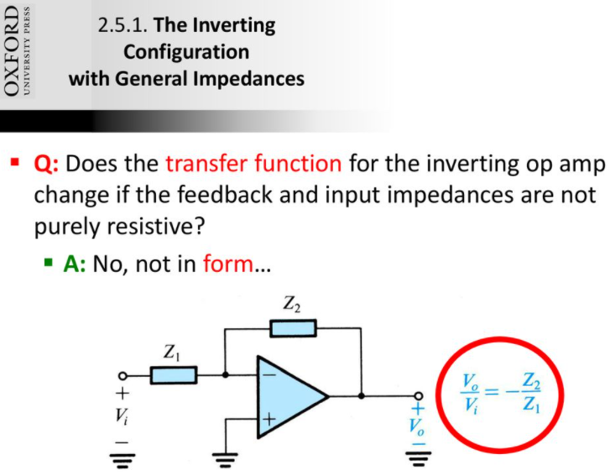

Slide 39
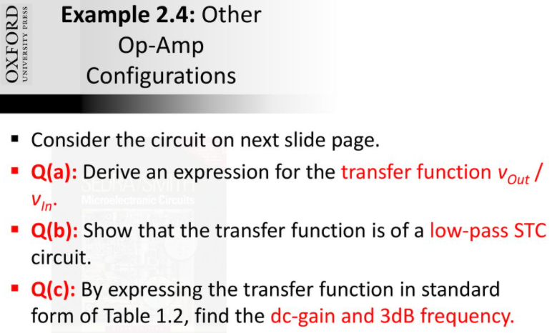

Slide 40
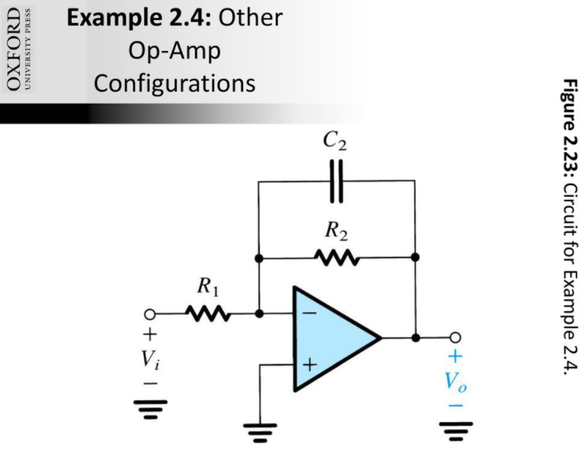

Slide 41
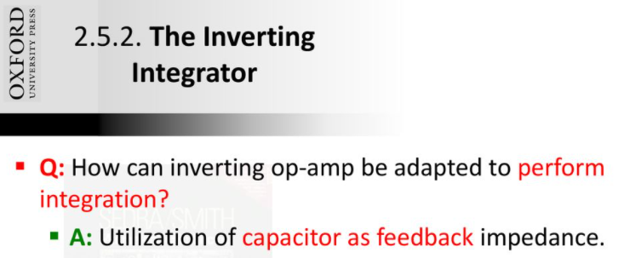

Slide 42
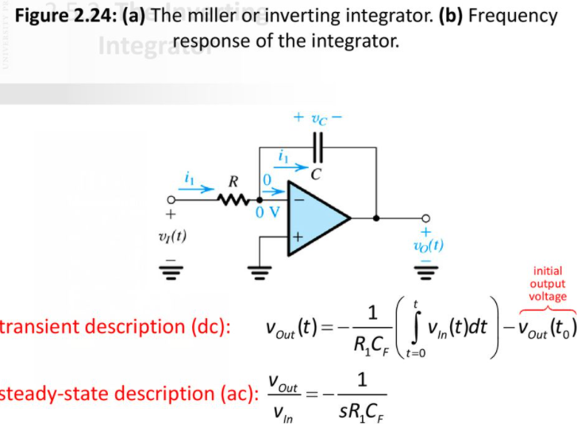

Slide 43
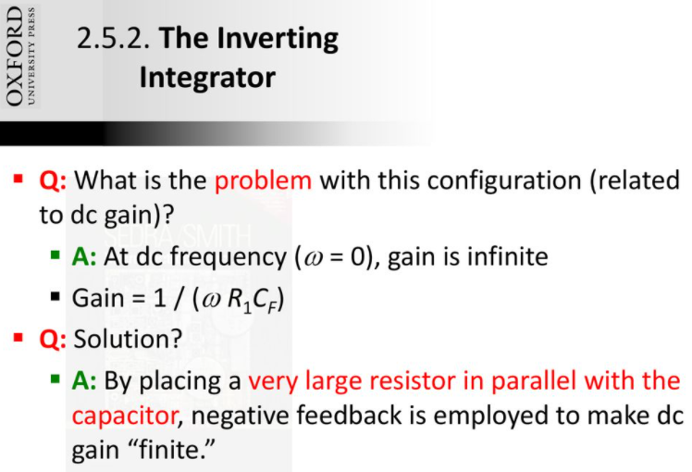

Slide 44
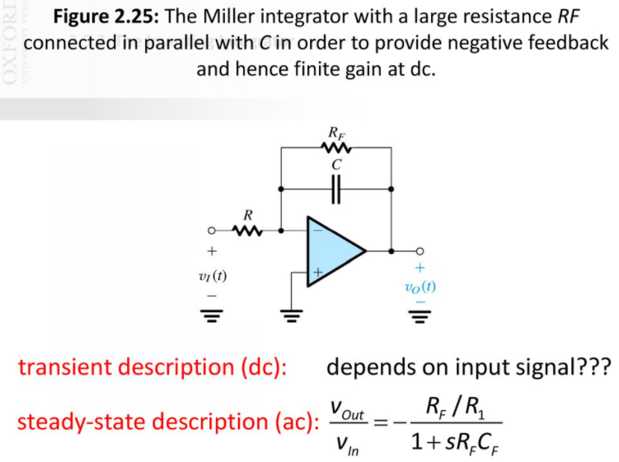

Slide 45
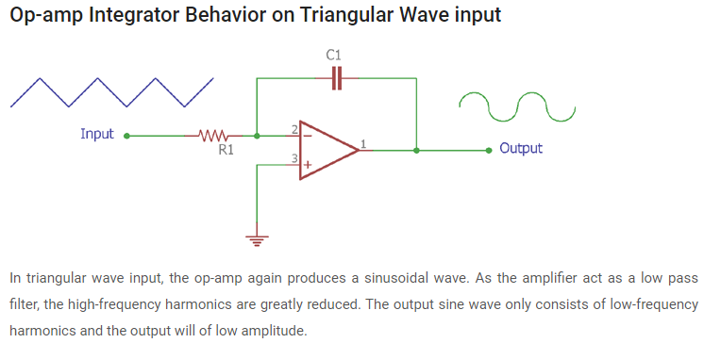

Slide 46
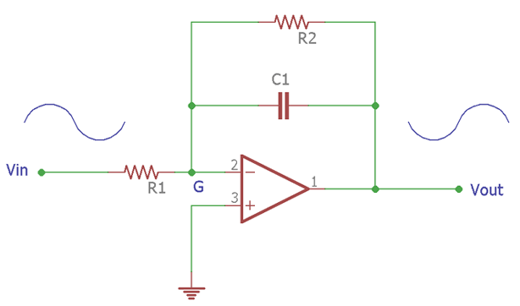
Op-amp Integrator Behavior on Sine Wave input
If the input across an op-amp based Integrator circuit is a sine wave, the Op-amp in integrator configuration produces a 90 degree out of phase sine wave across the output. This is called a cosine wave. During this situation, when the input is a sine wave, the integrator circuit acts as an active low pass filter.
In the above image, an additional resistor R2 is connected in parallel with the capacitor C1. The output sine wave is 90 degree out of phase.

Slide 47
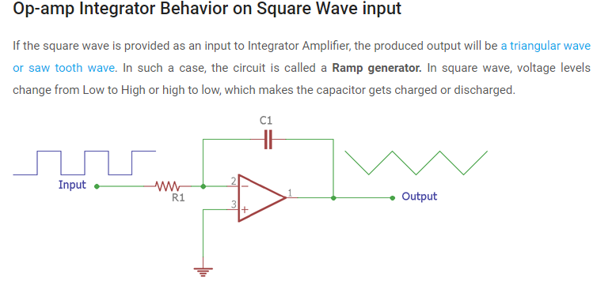

Slide 48
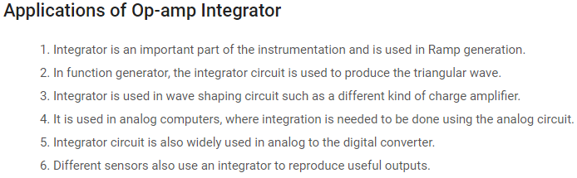

Slide 49
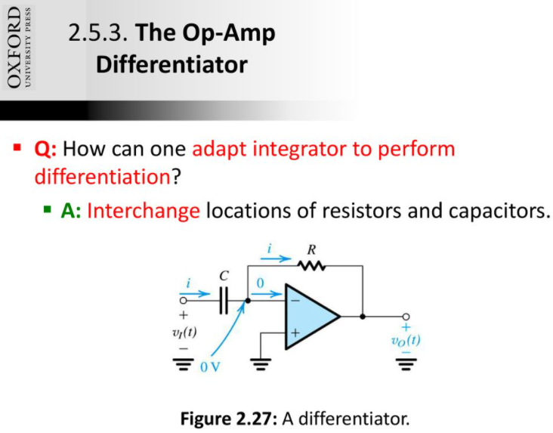

Slide 50
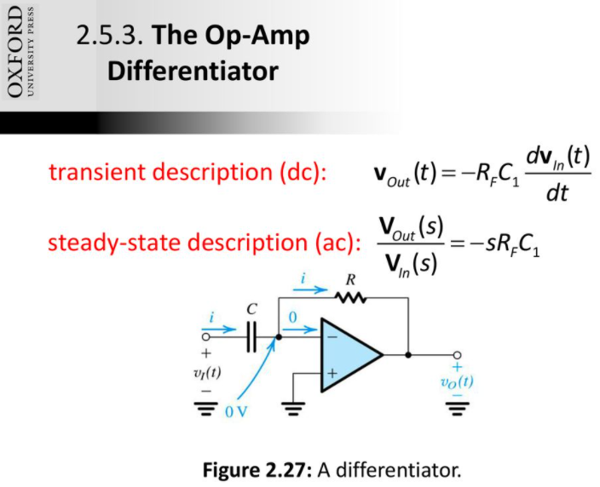

Slide 51


Slide 52

The differentiator circuit is essentially a high-pass filter. It can generate a square wave from a triangle wave input and produce alternating-direction voltage spikes when a square wave is applied. In ideal cases, a differentiator reverses the effects of an integrator on a waveform, and conversely.

Slide 53


Slide 54


Slide 55


Slide 56


Slide 57


Slide 58


Slide 59


Slide 60


Slide 61


Slide 62


Slide 63


Slide 64


Slide 65


Slide 66


Slide 67


Slide 68


Slide 69


Slide 70


Slide 71


Slide 72


Slide 73
Assignment No 1
To be submitted on 28th July 2021
Note : 50% marks reduction in case of late submission

